Slide 1
To Discount or Not To Discount - Data Driven Analysis Of Eniac's Price Strategy.
Project created by Felix Metz, Tilman Vogel and Lina Yordanova
December 14, 2023

Slide 2
Objectives
Analysis of database from 2017-01 until 2018-03
Recommendations on Discount Policy
Seasonal Price Distribution
Opportunities for Data Enhancement

Slide 3
Data Quality Problems in Sales Database
80% of incomplete orders removed from analysis
12% of order lines were corrupted → fixed
3% of price records were corrupted → fixed
90% of discount price records were corrupted → fixed
Semantic categories restored from numerical product type
Sufficient quality achieved
Notes:
80% of incomplete orders removed from analysis
12% of corrupted order line prices were fixed
3% of regular and 90% of discount product prices were fixed using heuristics on sales statistics
Only found a numerical product type in the database but over 99% in terms of sales mapped to semantic categories using product word statistics
→ sufficient data quality achieved for a consistent analysis

Slide 4
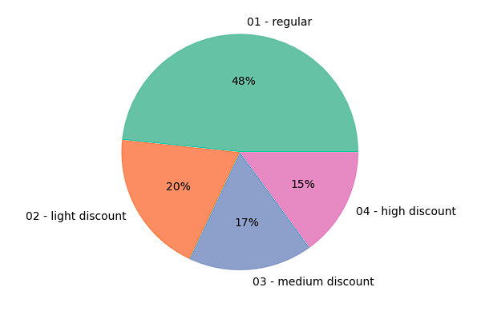
Overall revenue distribution
About 50% of the revenue comes from undiscounted products
Using quartiles per product from orderlines table

Slide 5
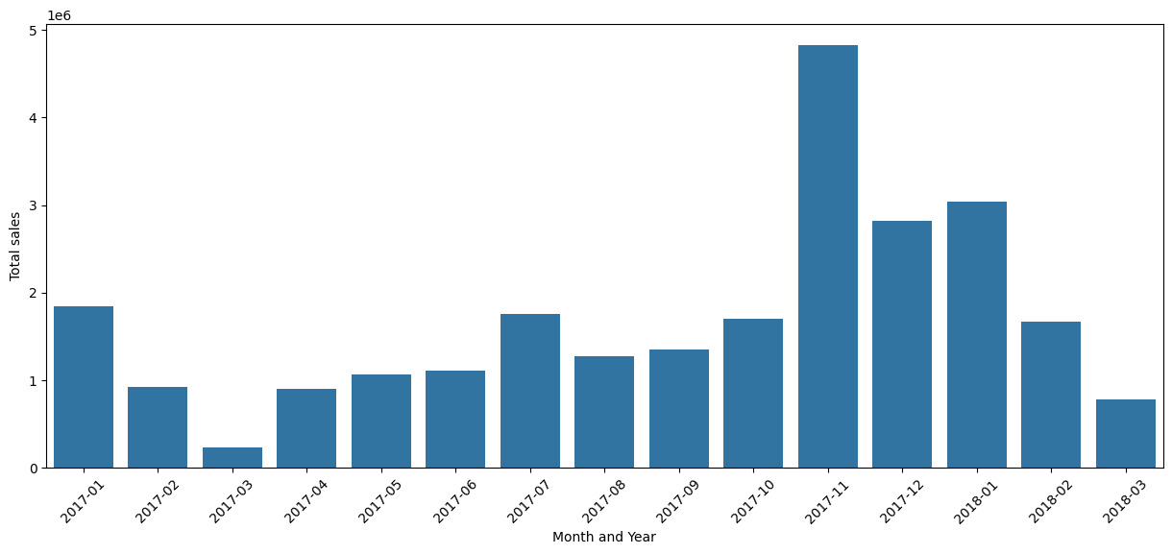
Seasonality Trends
A relationship between sales and special events like Black Friday and Christmas.
Notes:
As to be expected, seasonal holidays and Black Friday have a strong impact on sales
January discounts (fiscal end of year)

Slide 6
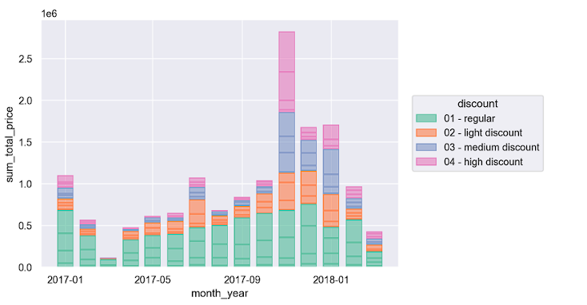
Distribution over time
Notes:
This plot shows the same as before but split into discount categories.
For that, we looked at quartiles of the price distribution in actual sales.
Black Friday: Most important high discounts
Christmas and January sales: light to medium discounts
January discounts achieve to counter-balance sales drop in regular sales.

Slide 7
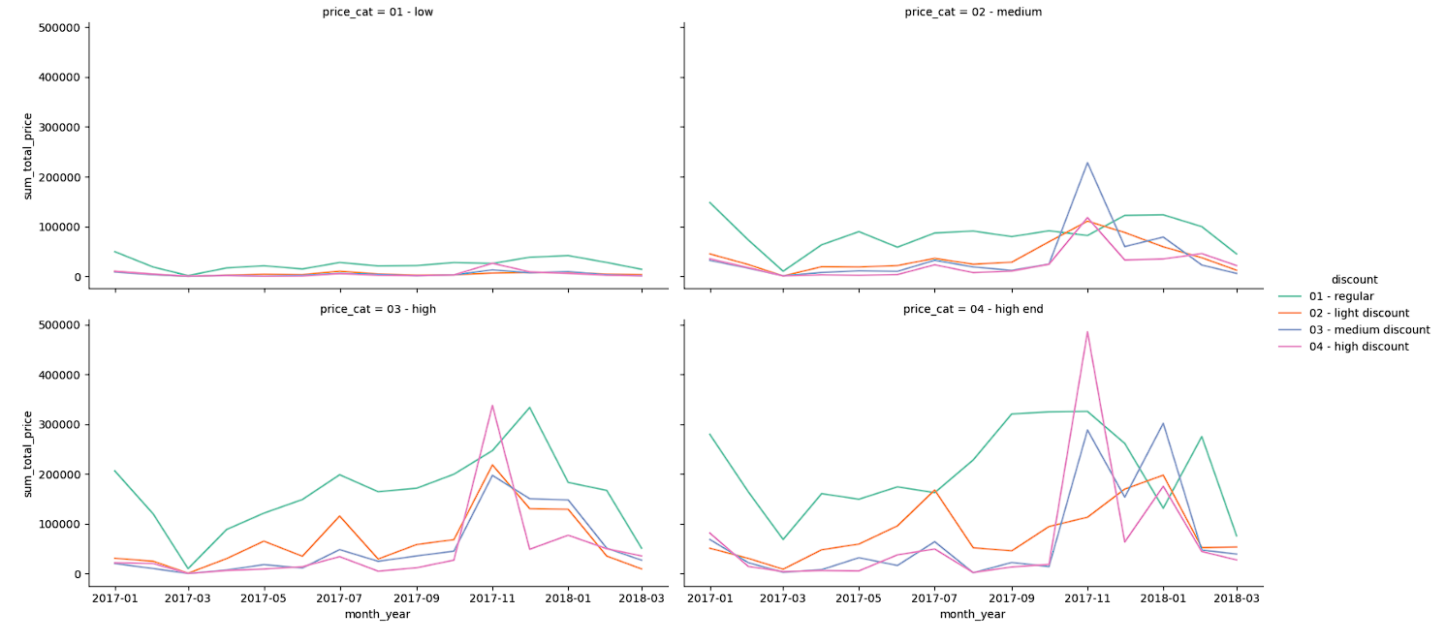
Distribution over product price categories
Notes:
Here, we further refine the analysis to product categories based on price percentiles
Low: below 50€
Medium: between 50 and 250€
High: between 250 and 1000€
High end: above 1000 €
Little effect on low-priced products
Bigger effect of medium discounts on medium-priced products with minor detrimental effect on regular sales
For high prices, we see a strong effect of high discounts on Black Friday and good sales for Christmas at regular prices
For high-end products, high discounts have a strong impact on Black Friday with successive drop in regular sales which are relatively strong even ahead of Black Friday.
['90%_price'] = 1083.04
['70%_price'] = 236.871885
['40%_price'] = 47.99

Slide 8
Conclusions
Focus on seasonal (Black Friday/Christmas) discounts
January discounts make sense
All-year discounts have low impact on sales
Technical recommendations:
Production database repair
Clear interface definitions
Data-quality monitoring
Notes:
Conclusions are: Focussing on seasonal discounts makes sense
January discounts help counter-balance post-Christmas drop and clearing of storage
All-year discounts are less relevant in comparison to regular sales
Technical recommendations:
Production database could get repaired using our heuristics
Future corruption must be prevented by clear interface definitions and ongoing data-quality monitoring.

